Slide 1
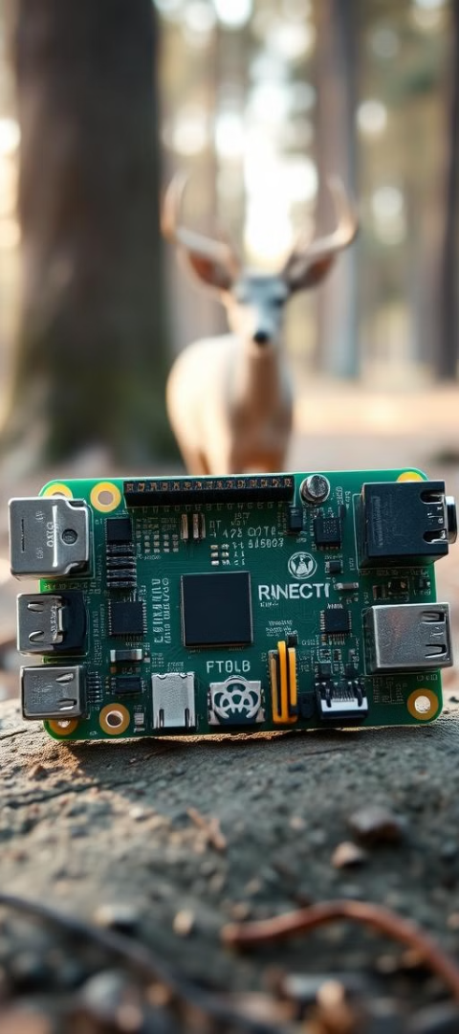
Animal Detection System
Presented by:
Sahitya Kushwaha
Parchuru Basheed
(623195)
(623193)
II-B.Tech. (ECE)
II- B.Tech. (ECE)

Slide 2
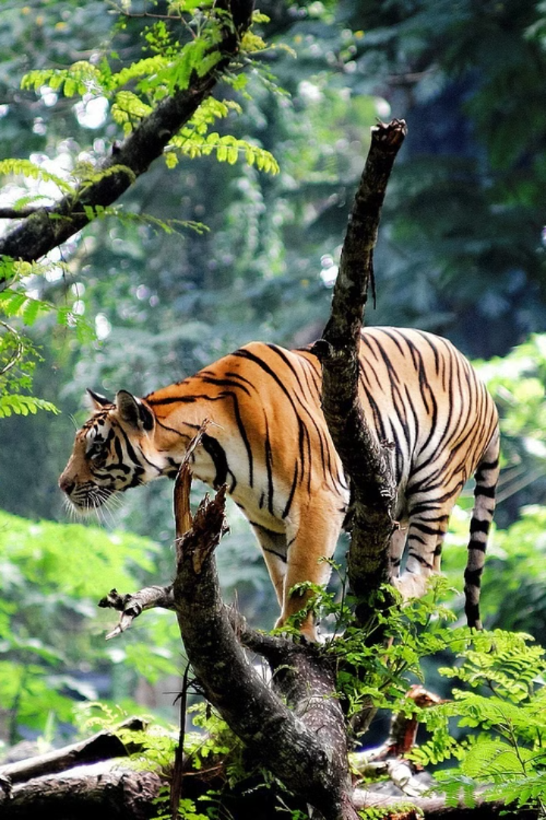
Introduction
Our project focuses on enhancing safety for both humans and wildlife through the development of an automated animal detection system. This system is designed to identify potentially hazardous animals and send real-time alerts to nearby residents so that they can be cautious.
This project combines the versatility of Raspberry Pi with the power of Python to create a cost-effective and efficient solution for wildlife monitoring, conservation efforts, and even home security.

Slide 3
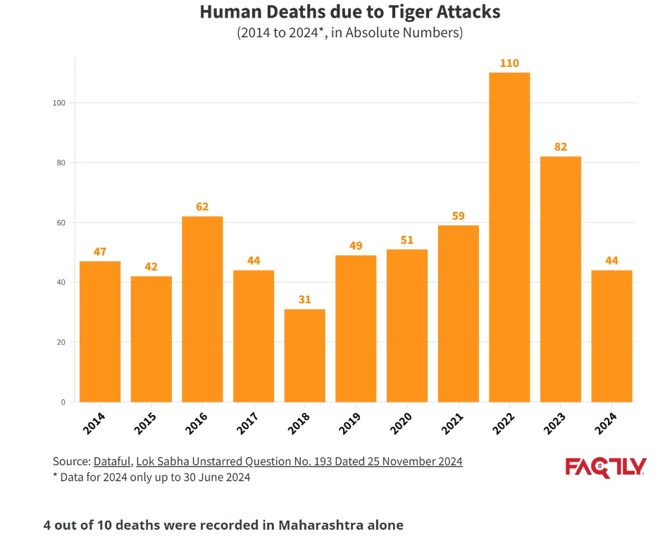
Motivation for the Project
As human populations grow, conflicts with wildlife increase, leading to safety risks and economic losses.
A smart Animal Detection System using Raspberry Pi and Python can mitigate these issues efficiently and affordably.
This project leverages technology for a practical, low-cost solution to enhance human-wildlife coexistence.

Slide 4

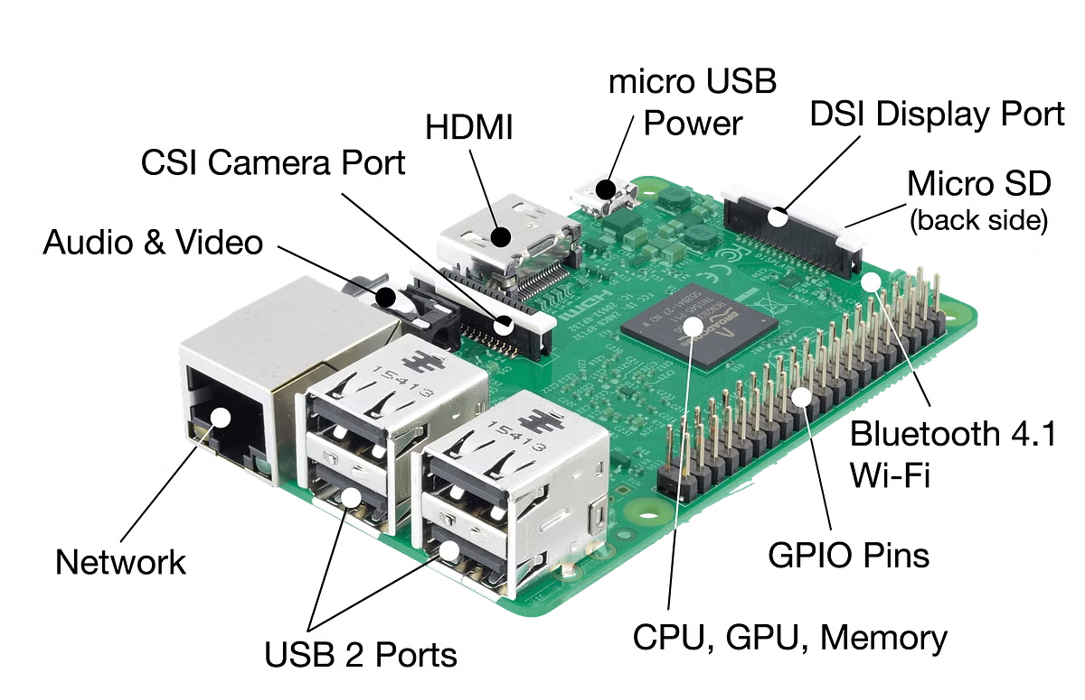
Why Raspberry Pi?
Raspberry Pi is a low-cost, versatile computer. It is small size and has low power consumption. It supports numerous interfaces and programming languages. This makes it perfect for custom applications.
Environmental Monitoring.
Home Automation.
Security Systems.

Slide 5



Hardware Components
Motion Sensor (Ultrasonic or PIR)
Camera
When motion is detected, the system triggers an alert.
High-resolution camera module for clear image capture. e.g. Raspberry Pi camera module V2
Cost-effective and easy to integrate with the Raspberry Pi.
Storage
High-capacity SD card to store captured images for further processing.

Slide 6
Software Components
Raspberry Pi OS: A Linux-based OS optimized for Raspberry Pi, providing a user-friendly environment to interact with hardware and run programs. Install it using the Raspberry Pi Imager tool.
Python: Primary language for controlling sensors, interfacing with hardware (e.g., ultrasonic sensor), and implementing the machine learning model for animal detection.
OpenCV: For image processing and handling webcam input.
PyTorch: For running the Convolutional Neural Network (CNN) model to detect and classify animals.
Twilio API: To send SMS alerts when an animal is detected, helping notify relevant personnel.

Slide 7
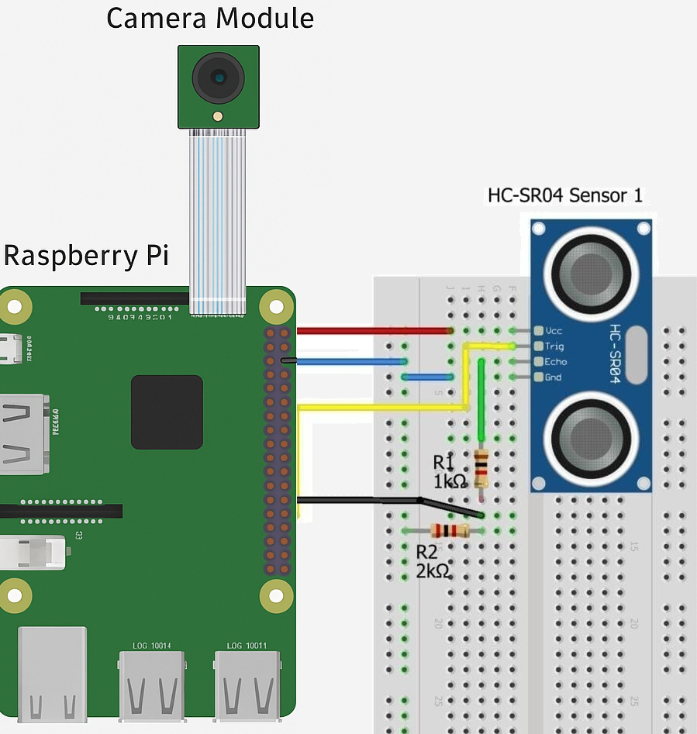
C IRCUIT DIAGRAM

Slide 8
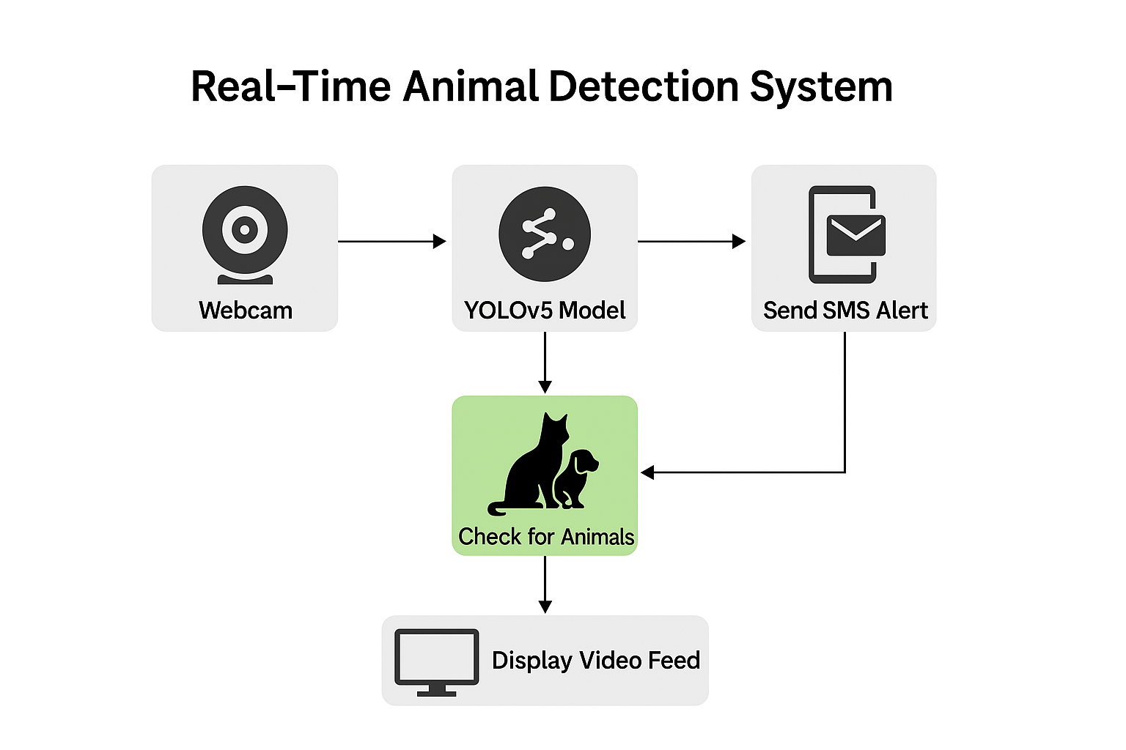
Methodology
1
Power On Raspberry Pi
2
Sensor Activation
3
Trigger Camera
4
Capture Image
5
Store on SD Card
6
Image processing and Animal Identification
7
Send alert via SMS

Slide 9
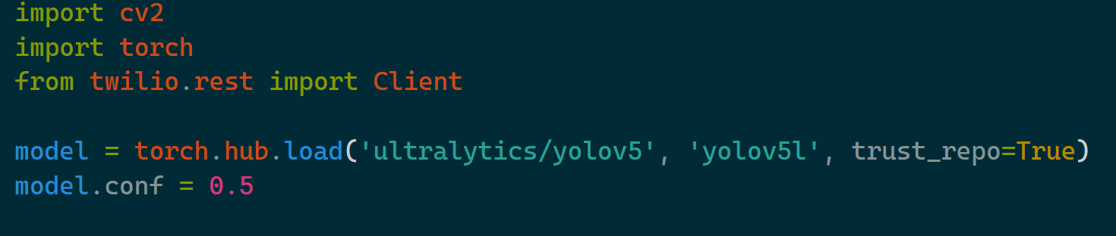
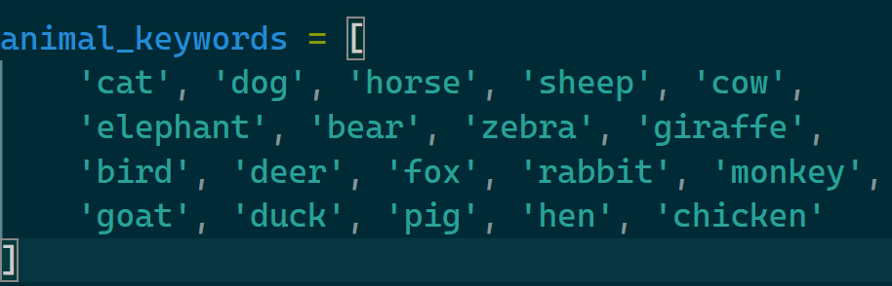
Code
1. Import Libraries & Initialize Model
We import computer vision (OpenCV),
machine learning (PyTorch), and Twilio for SMS alerts.
Then, we load the YOLOv5 model to detect objects in real time.
2. Define animal keywords
This list defines the animals we care about. If YOLO detects any of these, we trigger an alert.

Slide 10
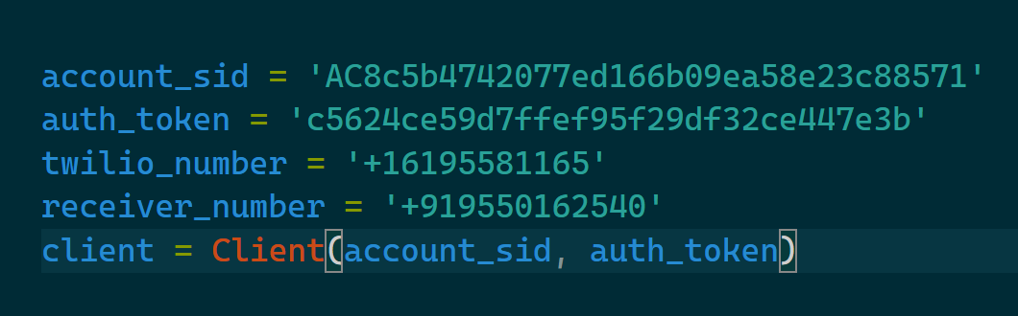
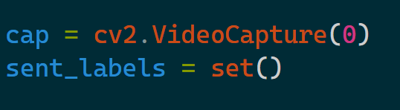
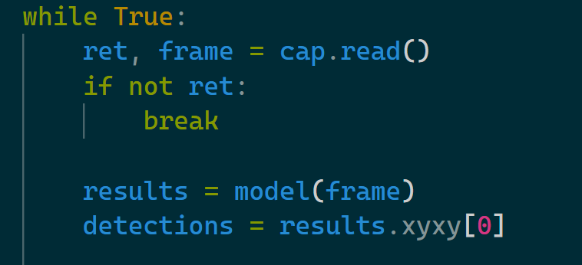



3. Set Up Twilio SMS Client
Twilio credentials allow the program to send SMS alerts to your phone when animals are detected.
4. Start Webcam and Prepare SMS Tracking
We start capturing video from the webcam and use sent_labels to avoid sending repeated alerts for the same animal
5. Real-Time Detection Loop
Continuously read frames from the webcam and run object detection using the YOLOv5 model.

Slide 11
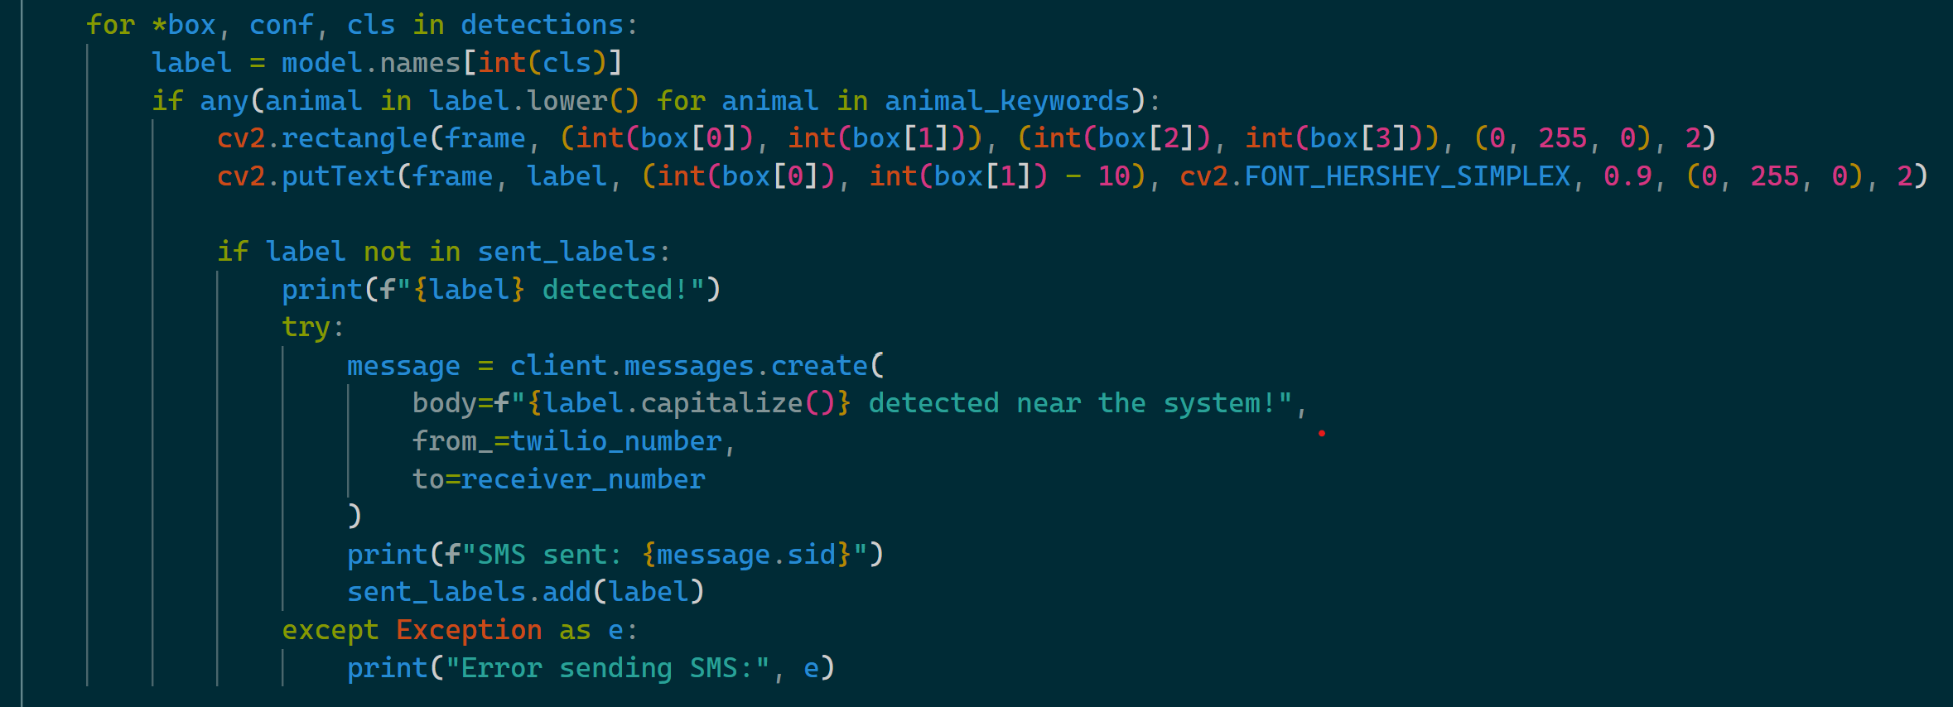
6. Check for Animals & Send Alerts
Loop through each detected object. If it's an animal, draw a bounding box and label it. If it hasn't been alerted before, send an SMS.

Slide 12
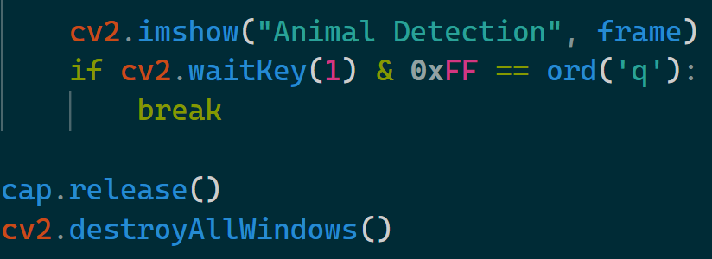
7. Display Video Feed & Exit on ‘Q’
Show the live feed with detections. Press 'Q' to exit the loop. Clean up webcam and windows after you're done.

Slide 13
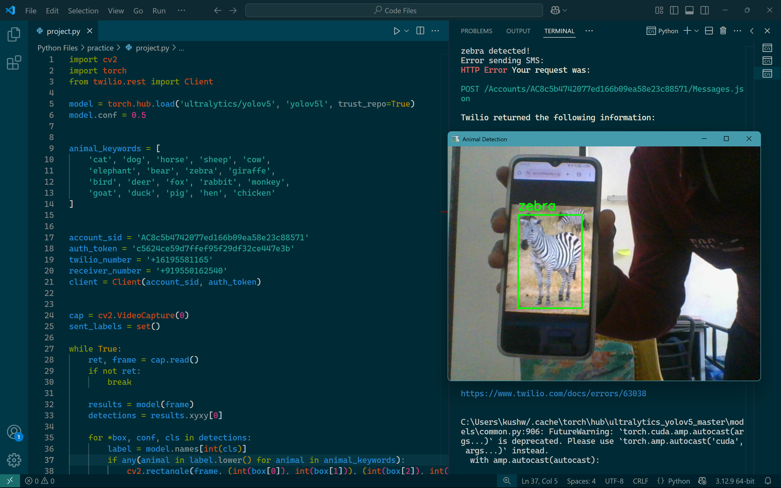
Code Simulation Results

Slide 14
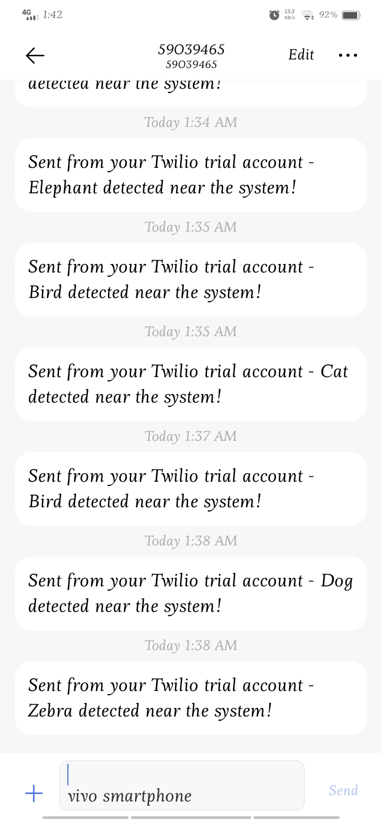
Code Simulation Results
SMS Alert on Animal Detection

Slide 15
Future Enhancements
Prototype
Weather
Build a hardware-based prototype for the project.
Build a weather-resistant enclosure to protect components.
Accuracy
Power
Improve accuracy by using larger training datasets.
Explore solar power and battery solutions.

Slide 16
Thank You
Open to questions.

